Slide 2





Southern Gulf Islands
Transportation Plan and Referendum

Slide 3
Origin and Rationale:
The project is in response to requests from residents and societies (eg MAP) for regional coordination of public transit and transportation alternatives
The CRD’s SGI Community Economic Sustainability Commission (“CESC”) requested the CRD establish a new Transportation Commission for the SGI.
The CRD can support administrative coordination and can access infrastructure funding from other levels of government.
CRD can hold Licenses of Occupation in the Provincial Road Right of Way which are needed to construct road side trails. However trail societies may not hold a License of Occupation.
BUT
Establishing a transportation service requires the assent of voters through a referendum process.

Slide 4
HOW?
Add a transportation levy to property tax
OPTIONS
Status quo
B. To raise $270,000 : $39/ Average property value
C To raise $450,000: $65/ Average property value
D. To raise $675,000: $98/ Average property value

Slide 5
Option D Recommended
An average of ~ $100/year for average home value of ~ $700,000 (SGIs)
~$15.00 per $100,000 of assessed property value
Exact assessment value not precise yet
Ultimately it would provide ~$675,000 annually
Would be phased in over a period of years

Slide 6
Governance of SGI Transportation Service
Establishment of a CRD commission
Made up of non-paid local residents from each island and modality
Supported by CRD staff
Local decision making (like PIPRC)

Slide 7
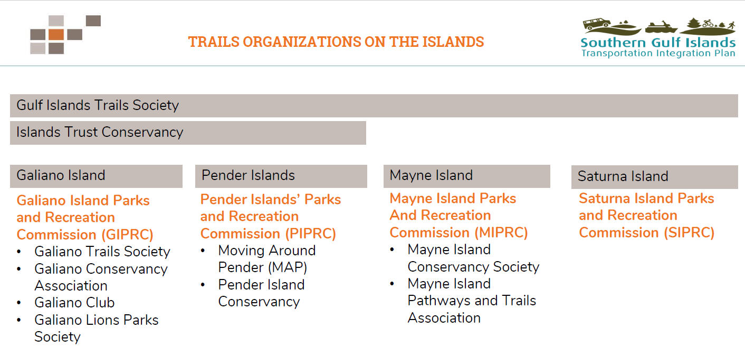

Slide 8
Public Engagement
Round 1- Fall 2021
969 quick polls completed
695 surveys completed (> 10% of pop)
Round 2- Winter-Spring 2022
365 surveys completed

Slide 9
Survey Respondents
(duration on islands)

Slide 16
Survey
Priorities

Slide 17
For information and input:
TransportationSGI@crd.bc.ca

